Slide 1
Project Host Behaviour Analysis for Country Greece
SQL query and Visualizations for two cities of Greece
NILABH KUMAR
PD13_021
RAMSHA SIDDIQUI
PD13_006
MASAI Mentor BHAVANA

Slide 2
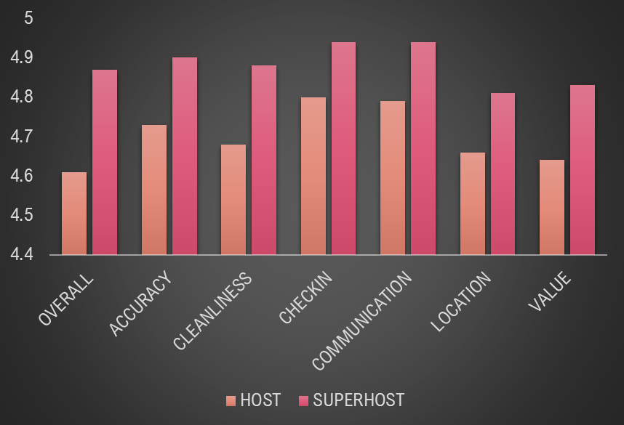
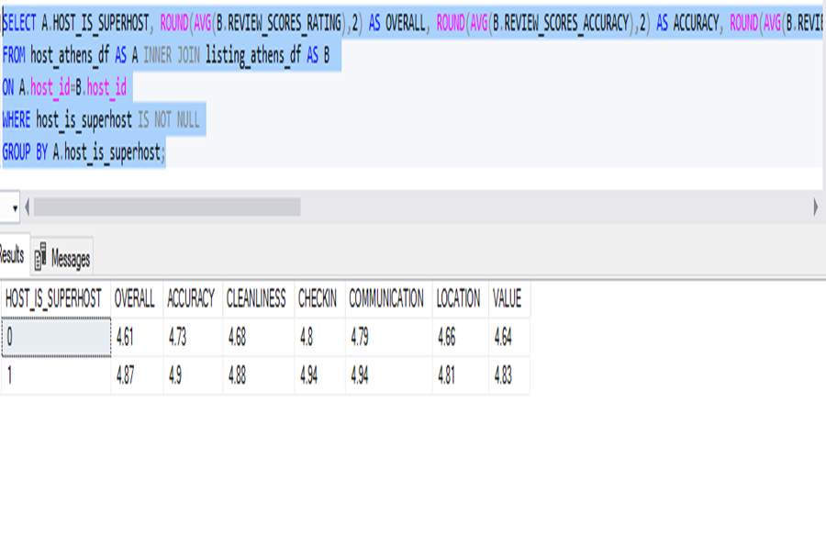
CITY ATHENS
AVERAGE REVIEW SCORES
The analysis shown below shows that on an average basis SUPERHOST have a higher review scores in all categories than the other HOSTS.

Slide 3
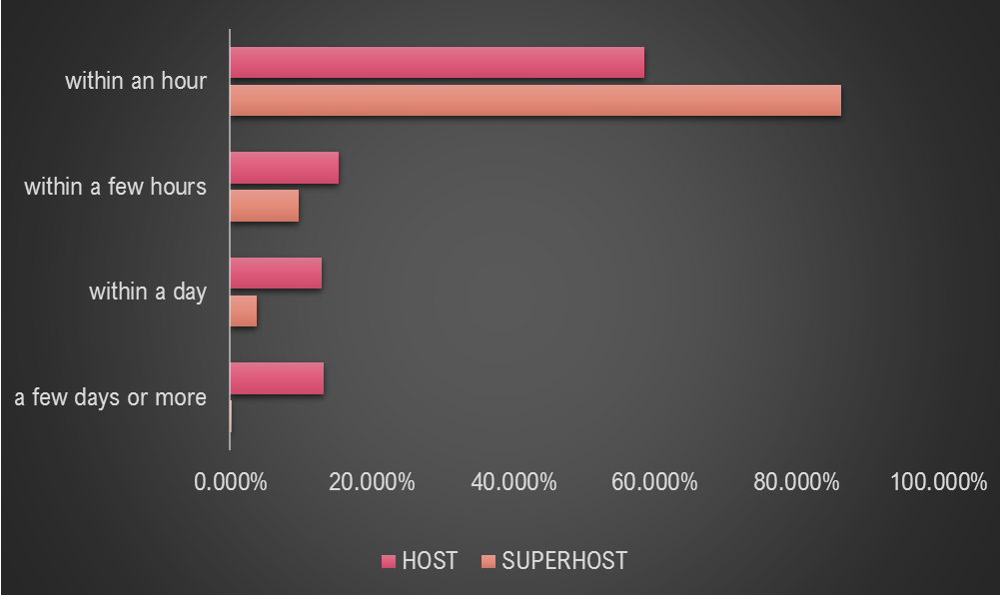
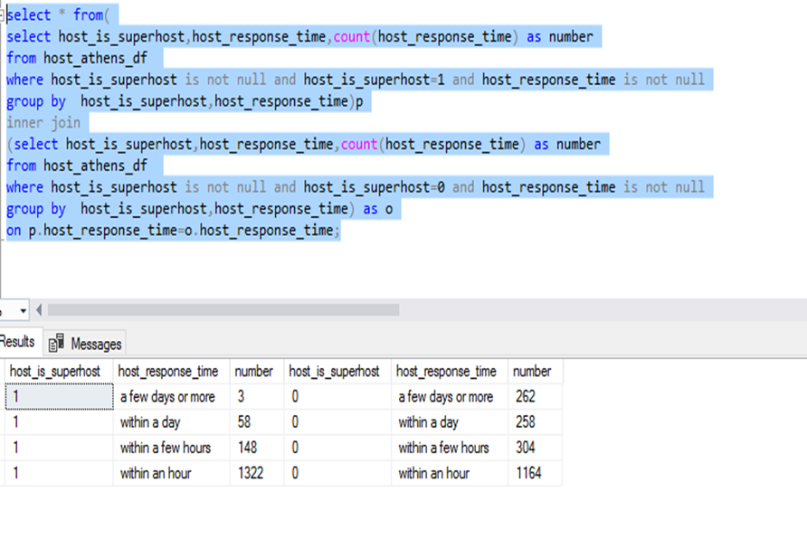
CITY ATHENS
NO. OF HOSTS RESPONDING WITHIN A PARTICULAR TIME FRAME
SUPERHOST has a high tendency of responding within an hour and there are no or negligible SUPERHOST
Who responds within a few days or more.

Slide 4
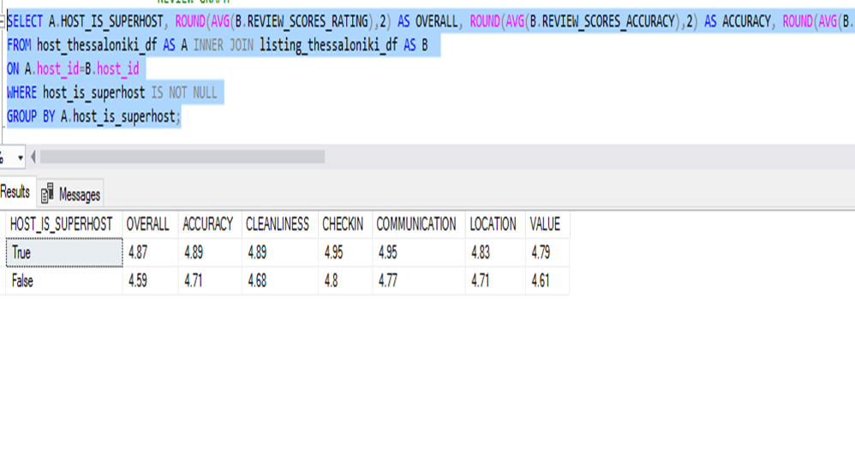
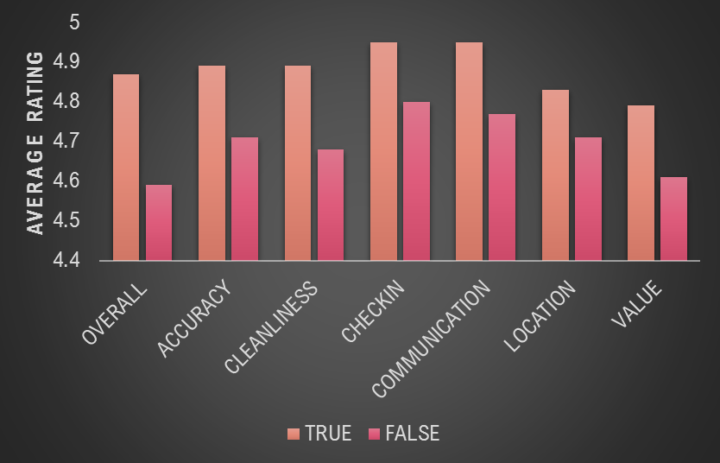
CITY THESSALONIKI
AVERAGE REVIEW SCORES
The analysis shown below shows that on an average basis SUPERHOST have a higher review scores in all categories than the other HOSTS.

Slide 5
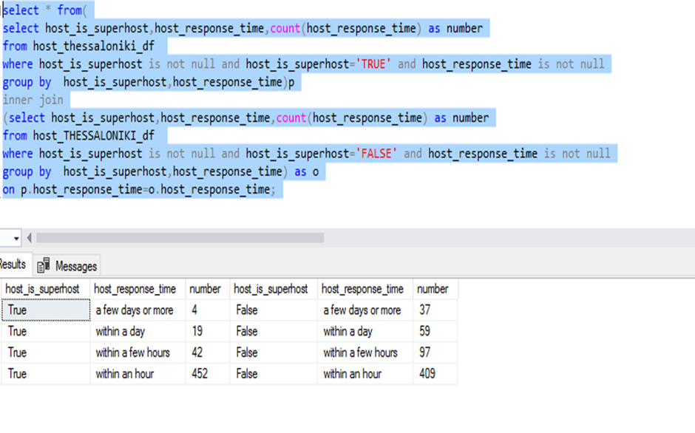
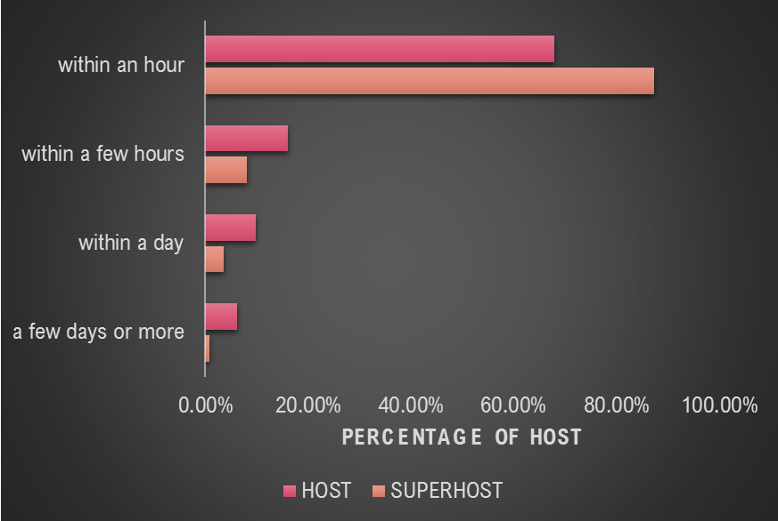
CITY THESSALONIKI
NO. OF HOSTS RESPONDING WITHIN A PARTICULAR TIME FRAME
SUPERHOST has a high tendency of responding within an hour and there are no or negligible SUPERHOST
Who responds within a few days or more.

Slide 6
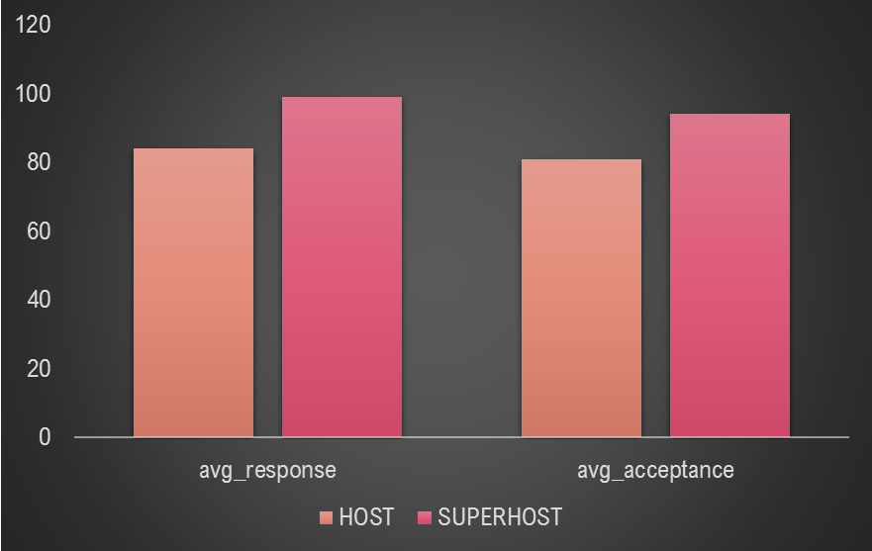
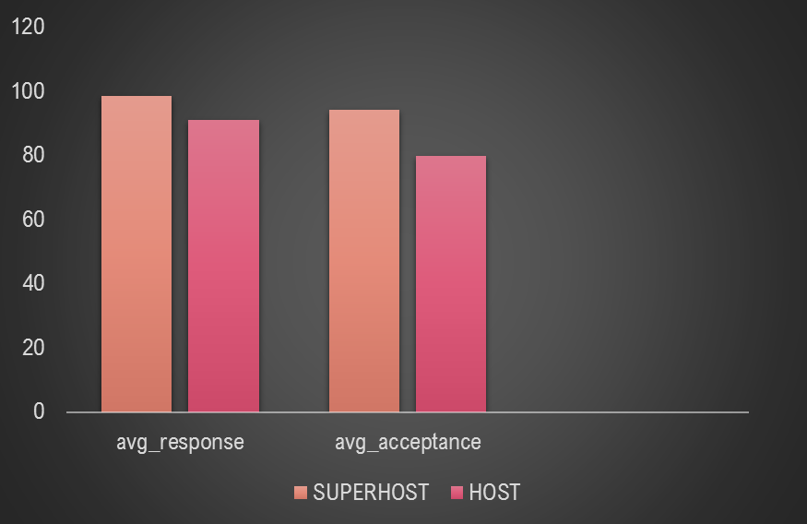
AVERAGE ACCEPTANCE AND RESPONSE RATE
CITY ATHENS
CITY THESSALONIKI

Slide 7
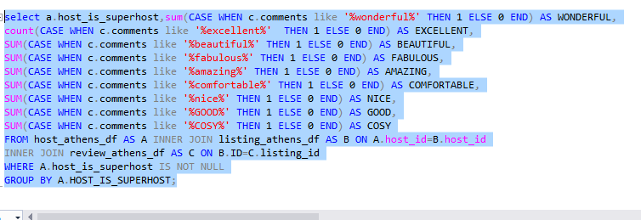
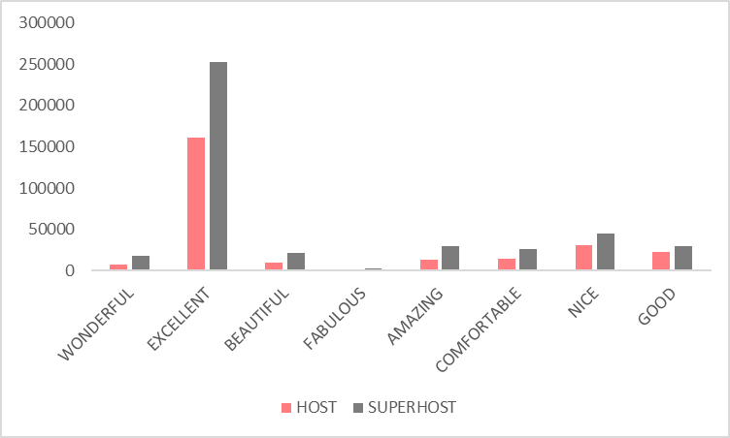
CITY ATHENS

Slide 8
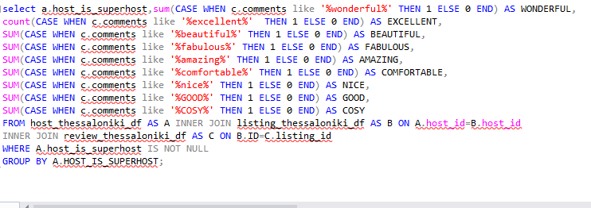
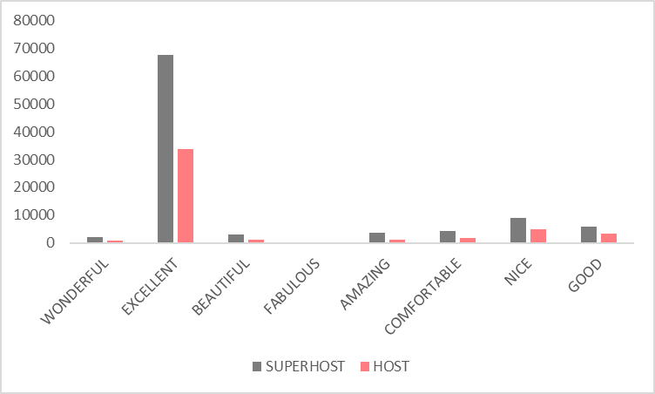
CITY THESSALONIKI

Slide 9
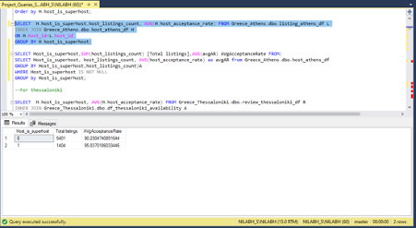
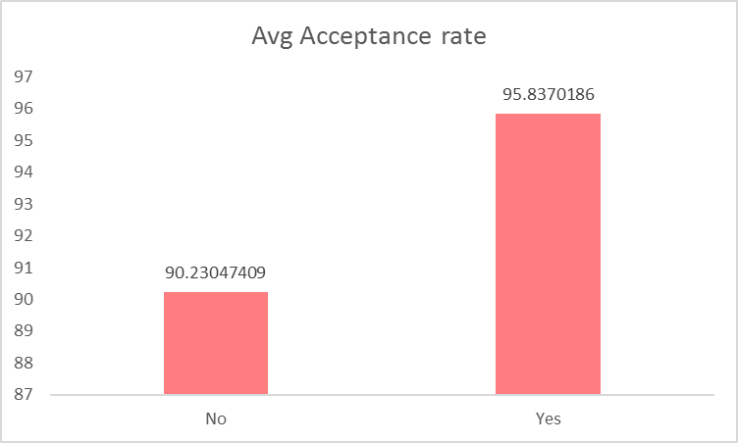
City Athens
Avg acceptance rate of super_host vs other_host

Slide 10
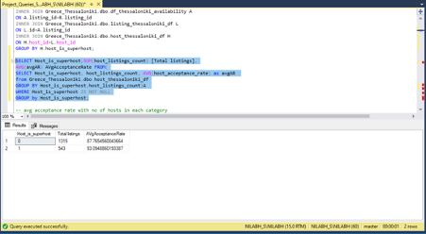
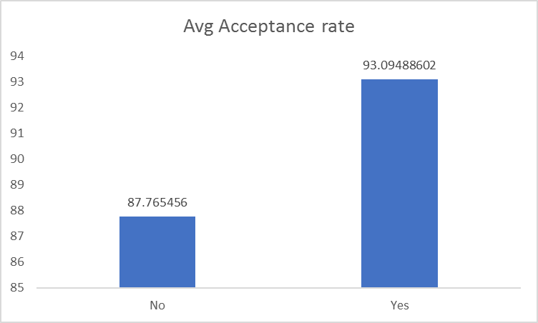
City Thessaloniki
Avg acceptance rate of super_host vs other_host

Slide 11
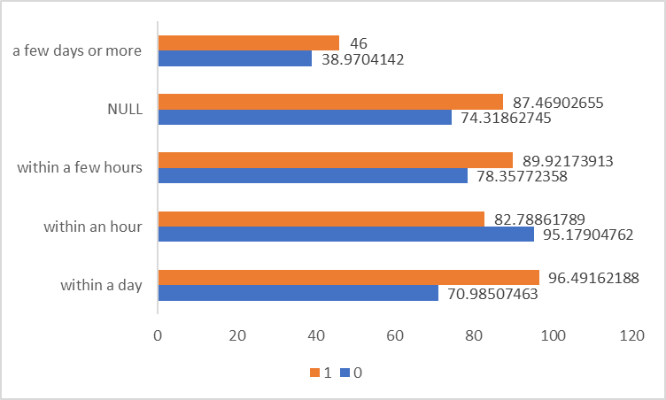
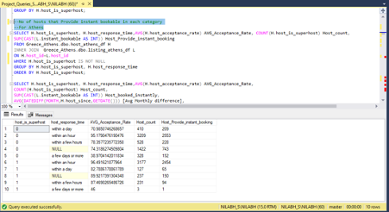
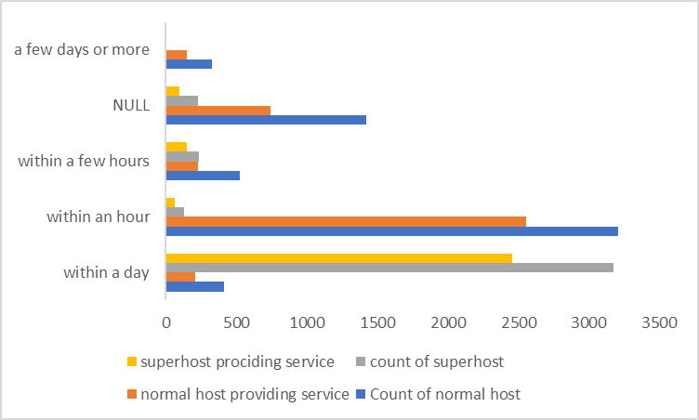
City Athens
No of hosts response time in each category
Avg acceptance rate Host count

Slide 12
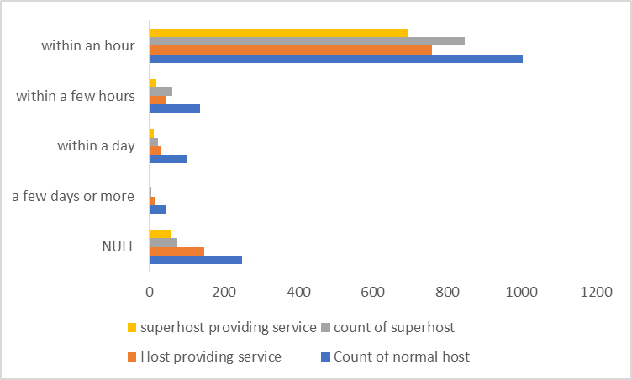
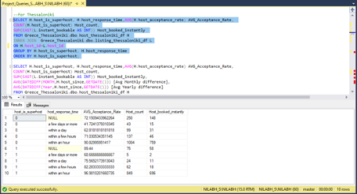
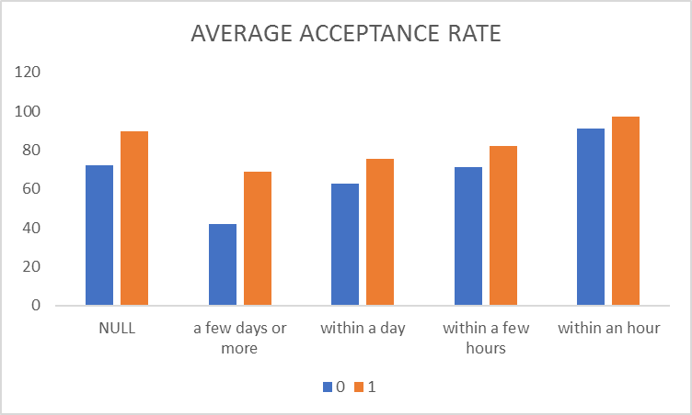
City Thessaloniki
No of hosts with response time in each category

Slide 13
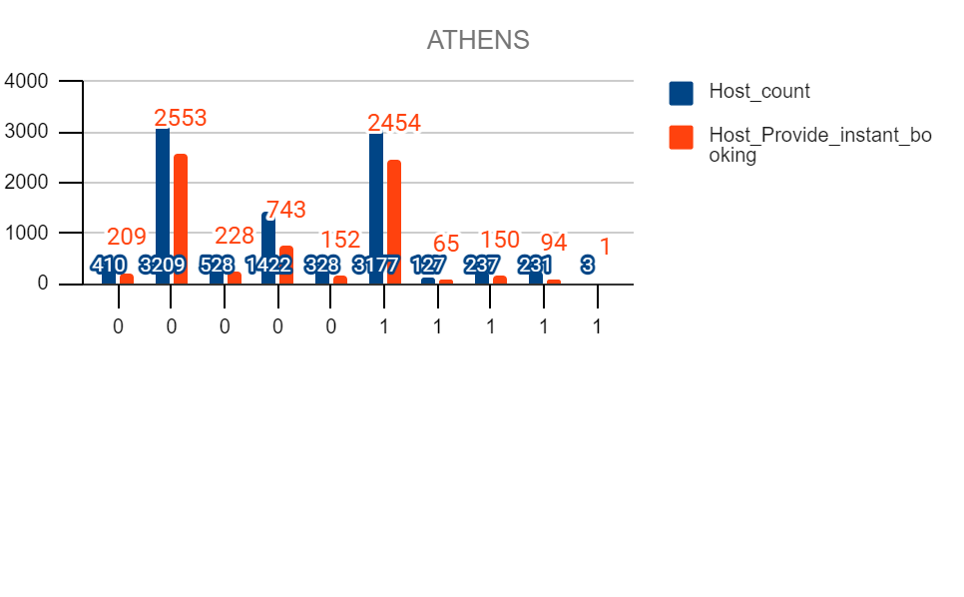
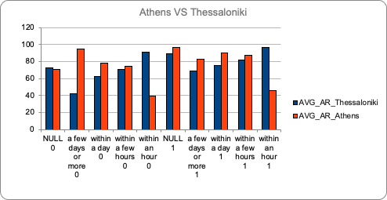
City Athens VS Thessaloniki
No of hosts that Provide instant bookable in each category
Host count (HC) vs Host providing instant service (S)
Average acceptance rate (AR)

Slide 14
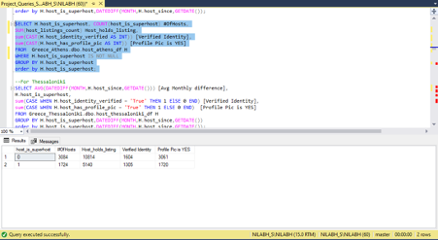
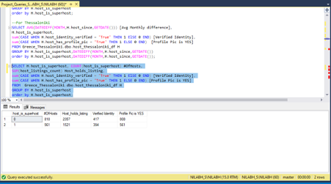
City Athens and Thessaloniki
Verified identity and profile pic is 'yes'

Slide 15
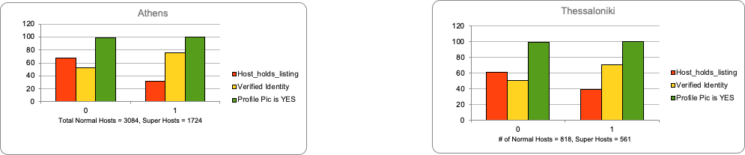
City Athens and Thessaloniki
Verified identity and profile pic is 'yes'

Slide 16
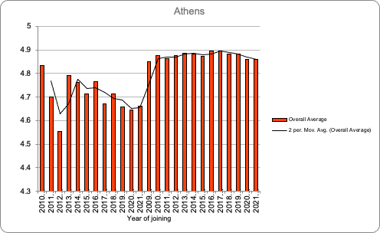
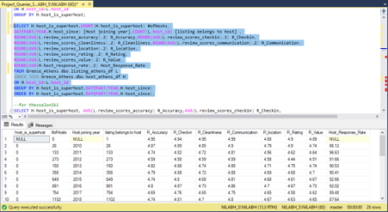
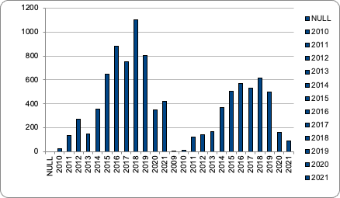
City Athens
AVG ratings and response rate for hosts according to year of joining the company
No of hosts that joined in particular year

Slide 17
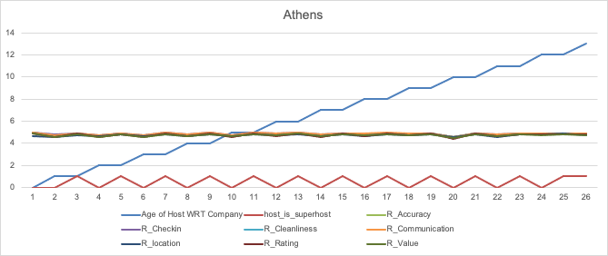
City Athens
AVG ratings for hosts according to year of joining the company

Slide 18
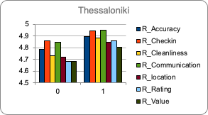
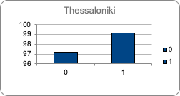
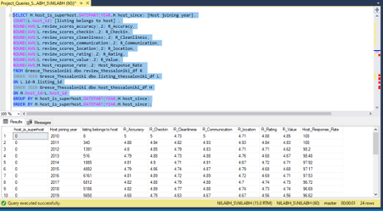
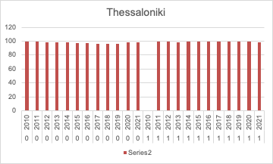
City Thessaloniki
AVG ratings and response rate for hosts according to year of joining the company
Reviews Host response rate
Host response rate over year of joining

Slide 19
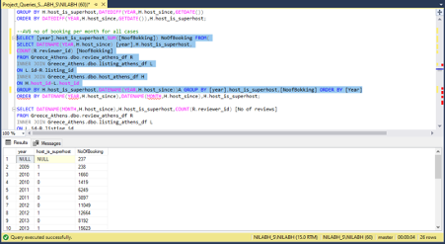
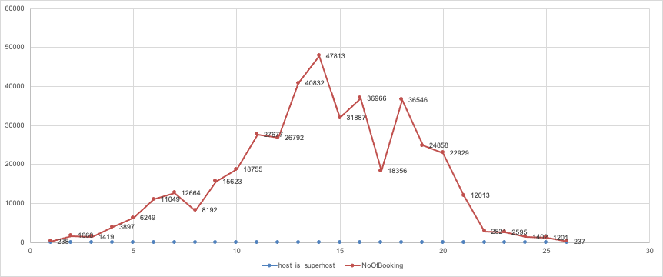
City Athens
Avg No of Booking
Extreme left blue dot (2009) represents ‘1’ and after that ‘1’ , ‘0’ alternates (2010-2021).

Slide 20
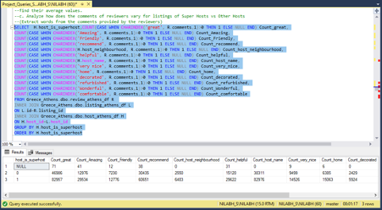
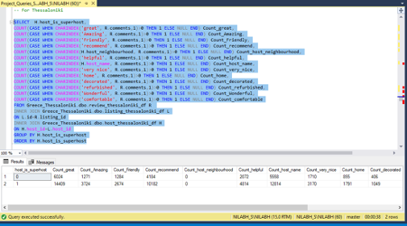
City Athens and Thessaloniki
Positive Reviews

Slide 21
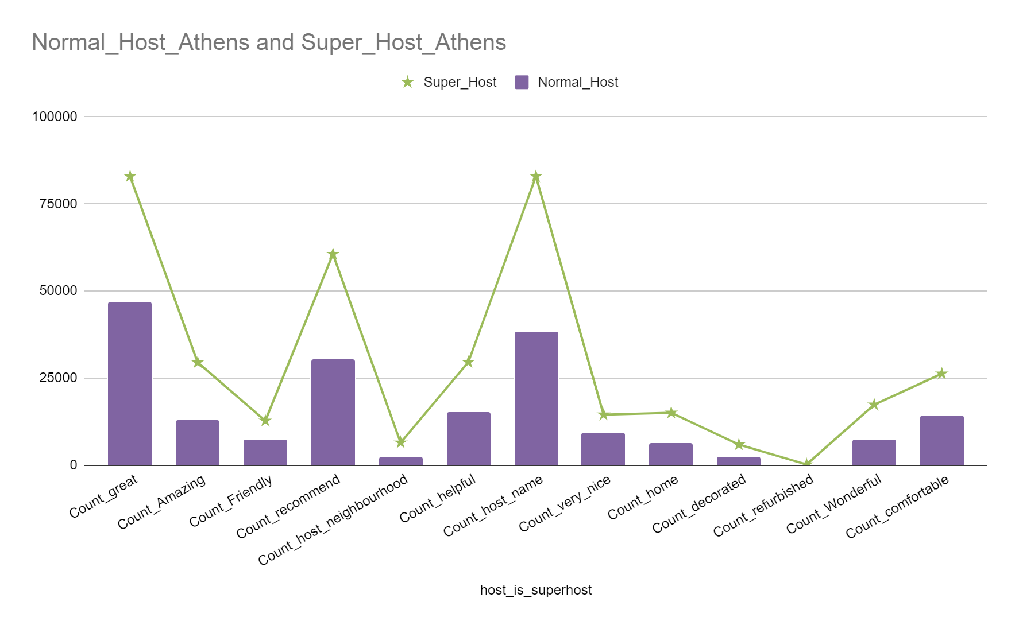
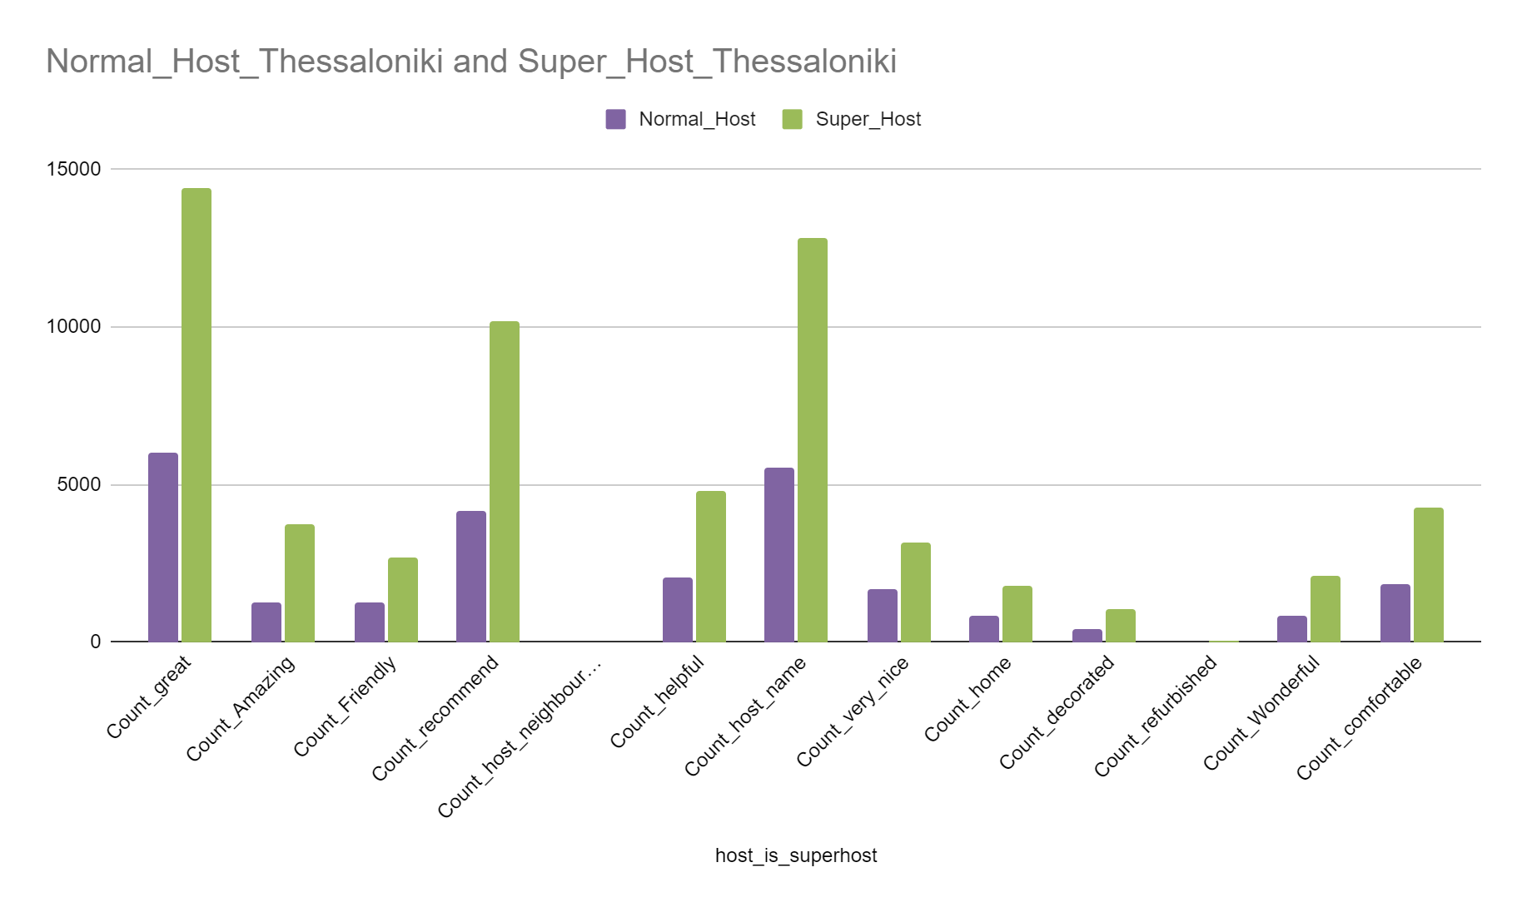
City Athens VS Thessaloniki
Positive Reviews

Slide 22
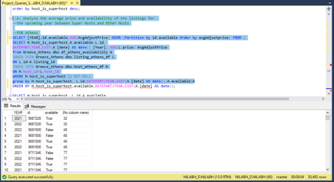
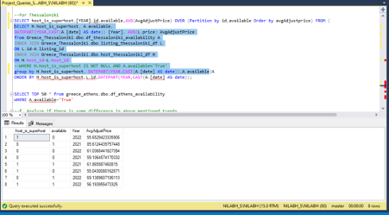
City Athens
e. Analyze the average price and availability of the listings for the upcoming year between Super Hosts and Other Hosts

Slide 23
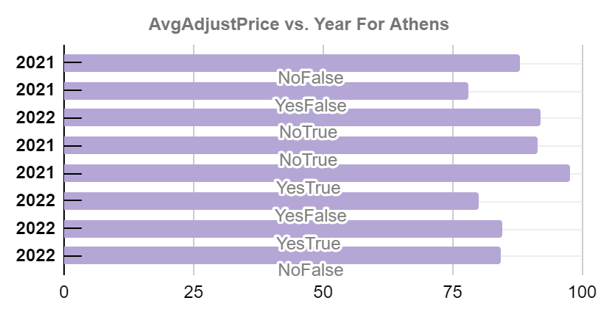
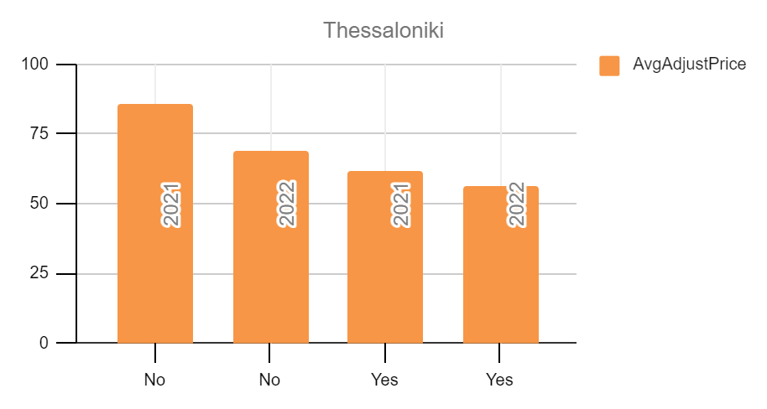
City Athens and Thessaloniki
e. Analyze the average price and availability of the listings for the upcoming year between Super Hosts and Other Hosts

Slide 24
KEY METRICS FOR BIFURCATION BETWEEN SUPERHOST AND NORMAL HOST
Acceptance rate
Response rate
Positive Reviews
Average rating according to year of joining
Verified identity of a host

